Slide 1
Airflow Architecture

Slide 2
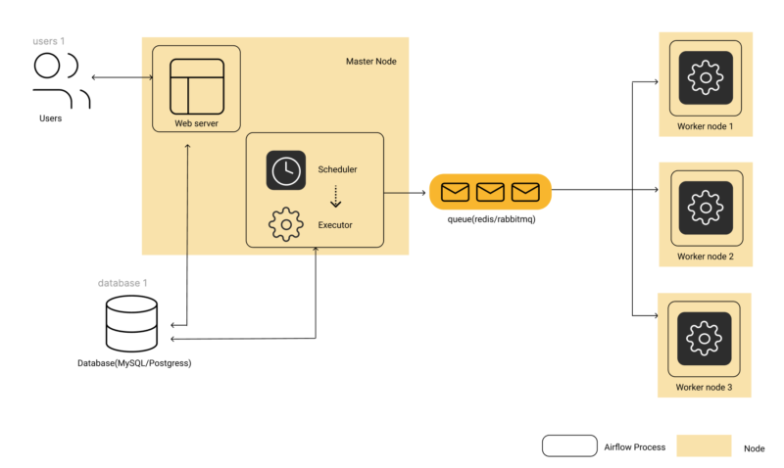

Slide 3
Task Life cycle

Slide 4
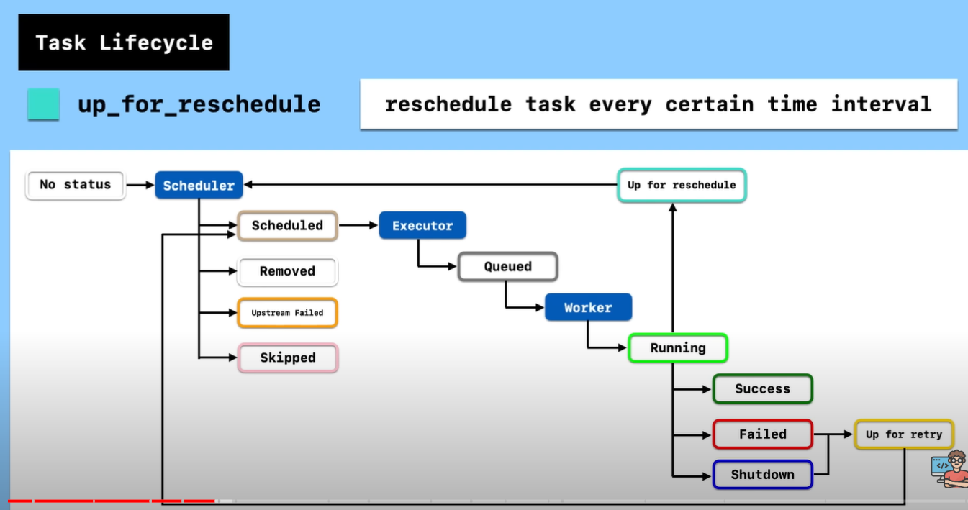

Slide 5
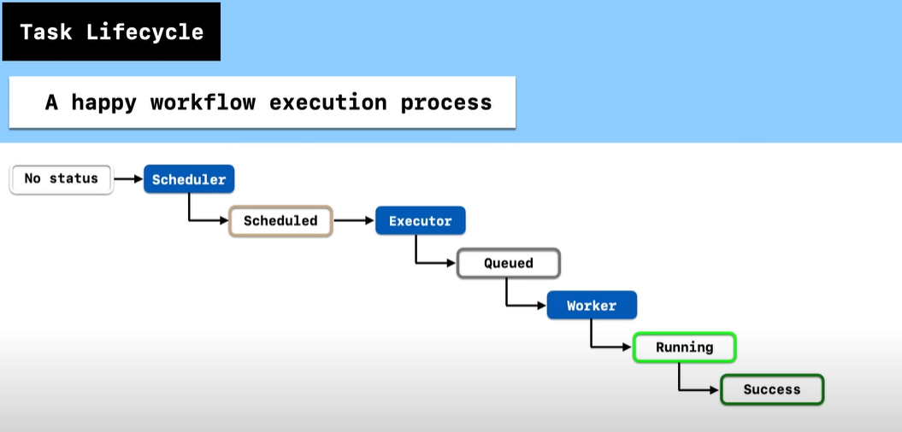

Slide 6
Xcom( cross communication)
1.Xcom is used for communicating between two tasks.
2. XComs (short for “cross-communications”) are a mechanism that let Tasks talk to each other,
as by default Tasks are entirely isolated and may be running on entirely different machines.
3. XComs are explicitly “pushed” and “pulled” to/from their storage using the xcom_push and xcom_pull methods on Task Instances. Many operators will auto-push their results into an XCom key called return_value if the do_xcom_push argument is set to True (as it is by default), and @task functions do this as well.

Slide 7
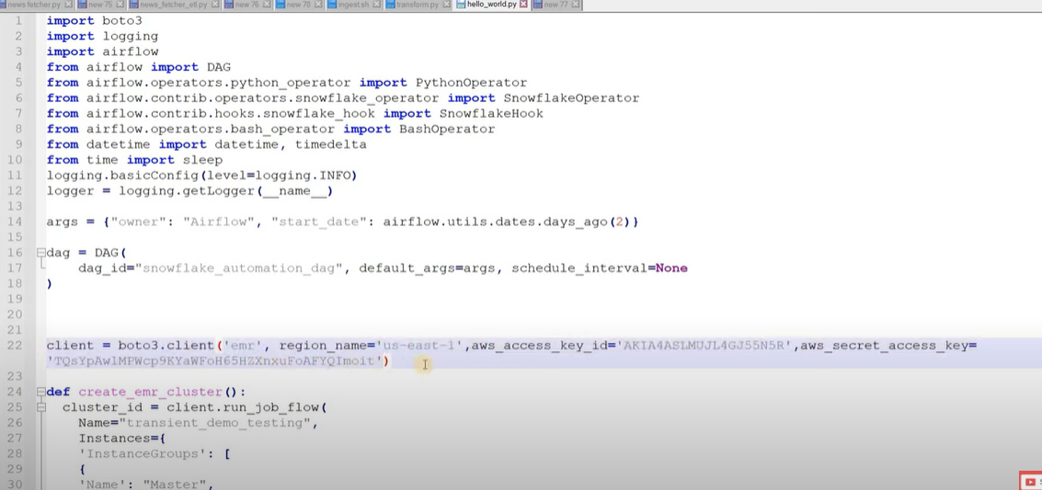

Slide 8
Configuration: The Airflow configuration file (airflow.cfg) allows administrators to
set various system-wide options, including database settings, logging configurations, and security settings.

